Slide 1
WORK UPDATES PRESENTATION
FROM
Rishabh Kumar Srivastva
SAP ID- 52108159

Slide 2
PYTHON BASIC TRAINING - till 13th Oct,2022
Functions in Python
Data Structures (30%)

Slide 3
Machine Learning Topics – till 13th Oct
Support Vector Machine( done with Hands on )
2. Naïve Bayes (done with Hands on)
Bayes Theorem
Naïve Bayes algorithm is a supervised learning algorithm, which is based on Bayes theorem and used for solving classification problems.
It is mainly used in text classification that includes a high-dimensional training dataset.

Slide 4
The fundamental Naive Bayes assumption is that each feature makes an: Independent, equal contribution to the outcome. This is a Disadvantage because it cannot establish the relationship between the features.
Types of Naïve Bayes Model:
There are two types of Naive Bayes Model, which are given below:
Gaussian: The Gaussian model assumes that features follow a normal distribution. This means if predictors take continuous values instead of discrete, then the model assumes that these values are sampled from the Gaussian distribution.
Multinomial: The Multinomial Naïve Bayes classifier is used when the data is multinomial distributed. It is primarily used for document classification problems, it means a particular document belongs to which category such as Sports, Politics, education, etc. The classifier uses the frequency of words for the predictors.

Slide 5
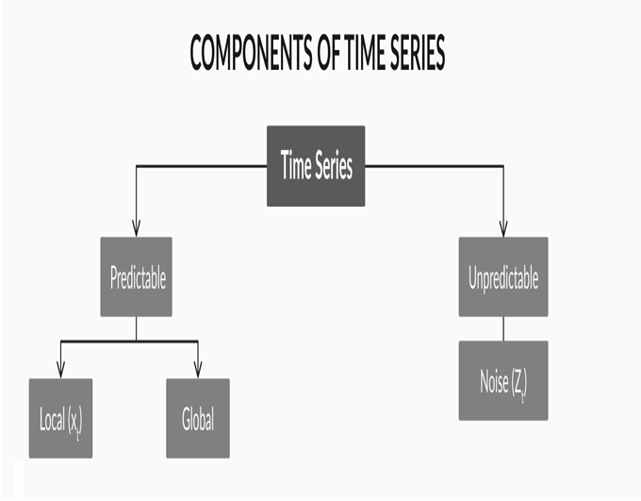
3. ARIMA Model ( Only Basics done):
Time Series vs Regression : In a time series, the sequence is important.
Components of a Time Series:

Slide 6

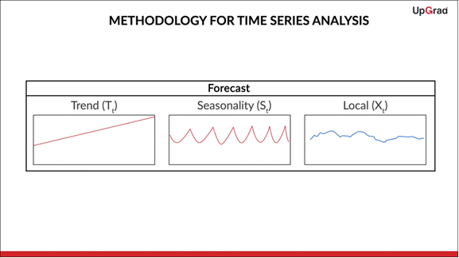
Additive and Mutiplicative Models
As a broad rule of thumb,
1. When the magnitude of the seasonal pattern in the data increases with an increase in data values and decreases with a decrease in the data values, the multiplicative model may be a better choice.
2. When the magnitude of the seasonal pattern in the data does not directly correlate with the value of the series, the additive model may be a better choice.
Methodology for Time Series : T + S + X

Slide 7
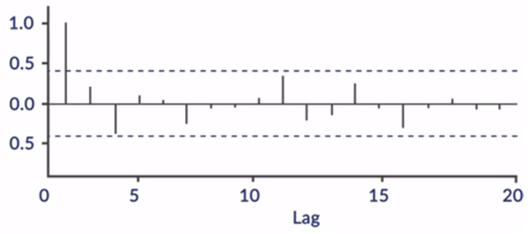
ACF and PACF
Ex: ACF plot for White Noise
AR Model
MA Model
ARMA
ARIMA

Slide 8
FUTURE SCOPE
1. PYTHON TRAINING
Data Structures (50% by next meeting )
2. MACHINE LEARNING
ARIMA (complete Hands-On practice)
Linear Regression (Basic and Mathematical concepts + Hands On practice)
Multiple Linear Regression (Basic and Mathematical concepts)

